Slide 1

Blood Metrics and Chronic Kidney Disease: Exploring Key Associations
Group 8
Eshani Hitendra Shah
Kanishka Angirish
Naga hemasree Sravanam
Priyankitha Kandi
Raajitha Muthyala

Slide 2


Introduction
Over 800 million people worldwide suffer from chronic kidney disease, a degenerative illness that affects more than 10% of the global population. It is one of the few non-communicable diseases that has seen an increase in related deaths over the past 20 years is chronic renal disease, which has become one of the primary causes of death worldwide (Kovesdy, 2022).

Slide 3
Aim: Investigate the relationship between blood parameters, comorbidities, and chronic kidney disease using statistical analysis.
Purpose: To identify potential risk factors and implications for managing chronic kidney disease through understanding blood metrics and associated health conditions.
Research question 1: How are blood glucose (bgr) and urea levels (bu) associated with chronic kidney disease?
Null Hypothesis (H0): There is no significant association between blood glucose levels (bgr) and blood urea levels (bu) with chronic kidney disease.
Alternative Hypothesis (H1): There is a significant association between blood glucose levels (bgr) and blood urea levels (bu) with chronic kidney disease.
Research question 2: What is the association between bacteria (ba) and hypertension (htn) with chronic kidney disease?
Null Hypothesis (H0): There is no significant association between ba and htn with chronic kidney disease.
Alternative Hypothesis (H1): There is a significant association between ba and htn with chronic kidney disease.

Slide 4
Dataset Description
The dataset used in this study consists of 400 observations and 26 variables, including demographic information, blood test results, comorbidities, and the presence or absence of chronic kidney disease. The variables of interest include blood glucose levels (bgr), blood urea levels (bu), presence of bacteria (ba), and hypertension (htn), and presence of ckd (class). Additionally, the dataset contains information on other factors such as age, blood pressure, and various other blood test results.
Variables
Numerical: age - age, bp - blood pressure, sg - specific gravity, al - albumin, su - sugar, bgr - blood glucose random, bu - blood urea, sc - serum creatinine, sod - sodium, pot - potassium, hemo - hemoglobin, pcv - packed cell volume, wc - white blood cell count, rc - red blood cell count
Categorical: rbc - red blood cells, pc - pus cell, pcc - pus cell clumps, ba - bacteria, htn - hypertension, dm - diabetes mellitus, cad - coronary artery disease, appet - appetite, pe - pedal edema, ane - anemia, class - class

Slide 5
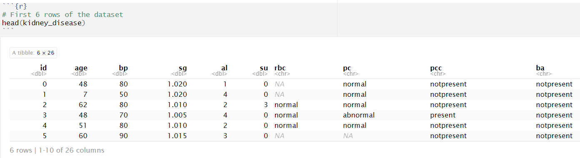
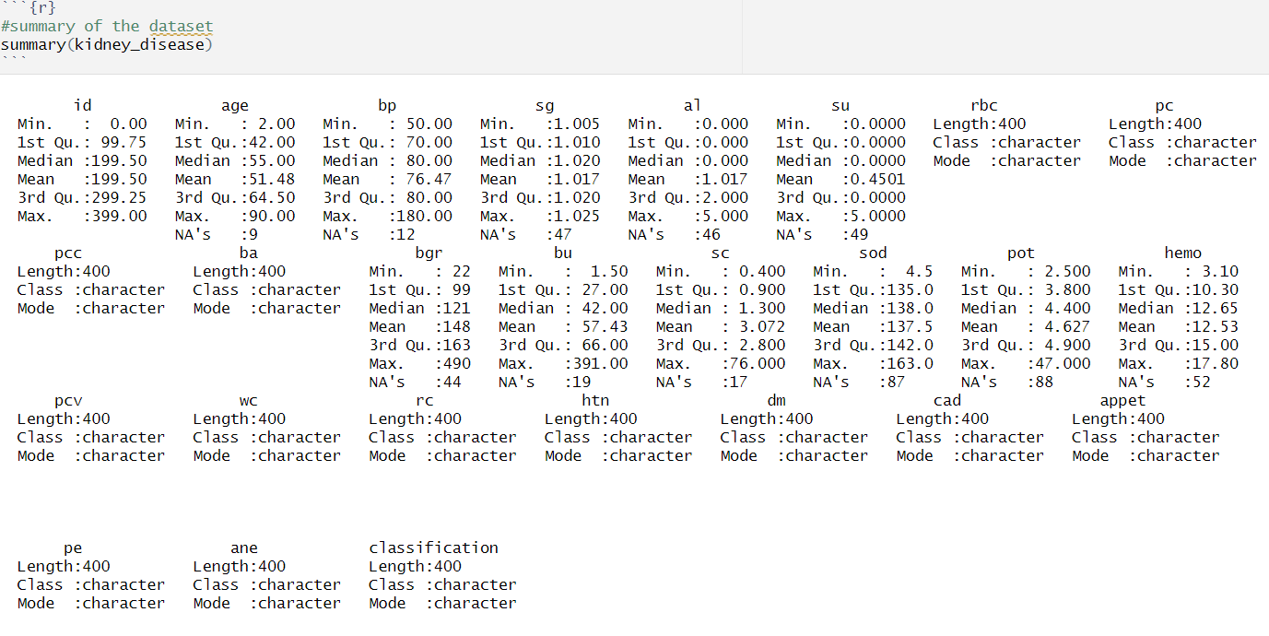
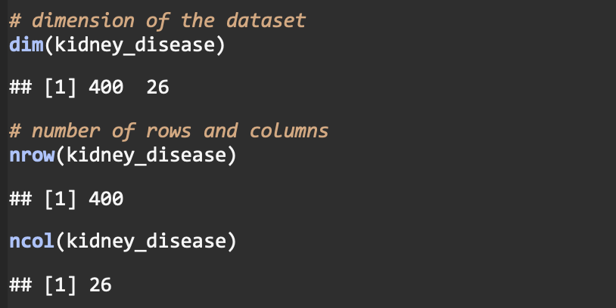
Data Importing and Dataset Description
We have imported dataset into RStudio, followed by reading csv file using read_csv function.
We examined the data for the first 6 rows of the data set by using the command “head(kidney_disease)”​
We examined the dimension of the dataset using dim() and for the individual row and column counts, we use nrow() and ncol().
Next, we obtained the summary of the dataset by using the command “summary(kidney_disease)”​

Slide 6
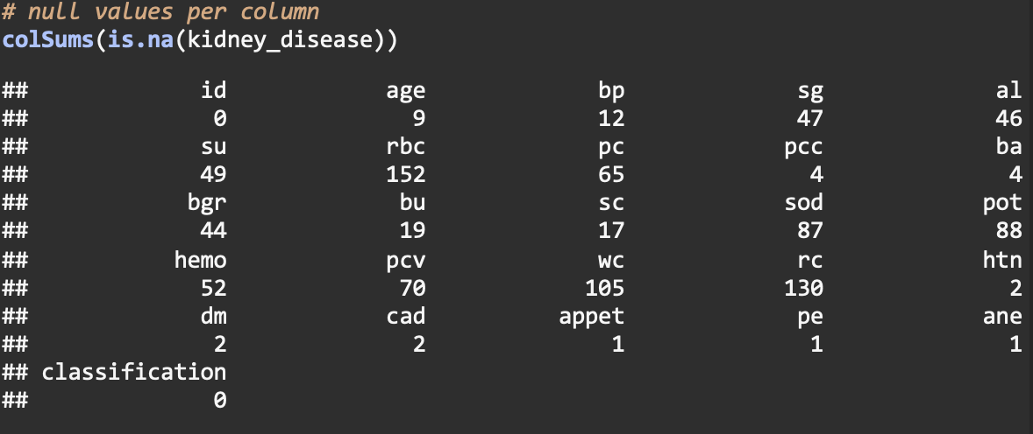
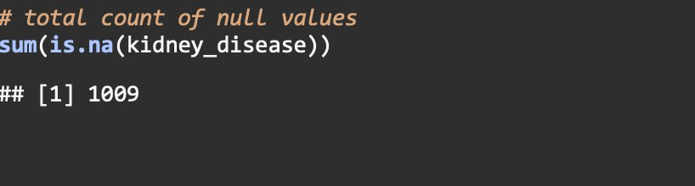
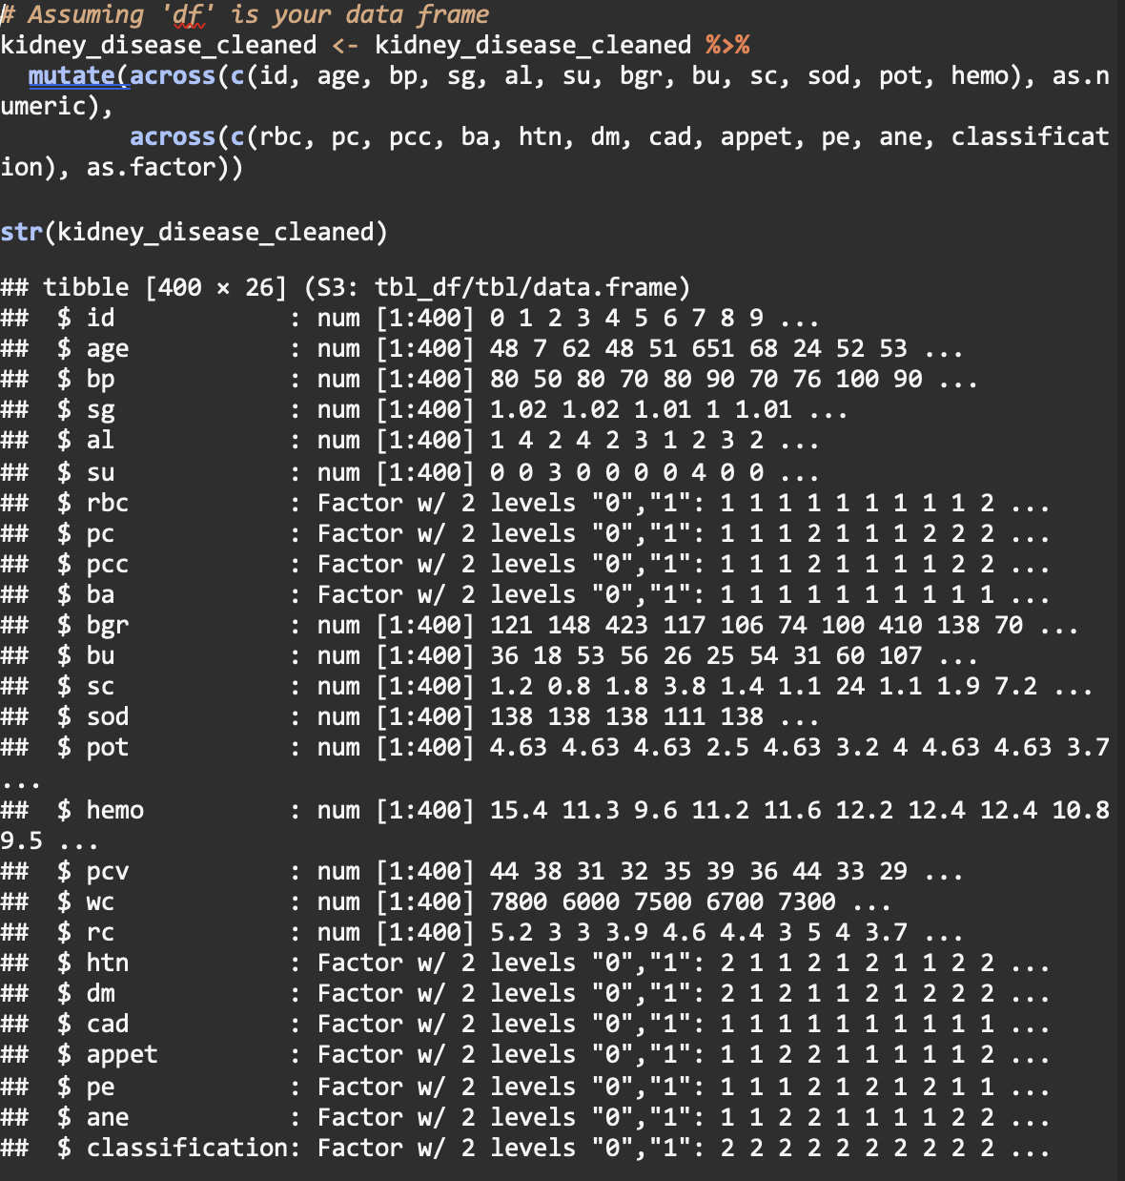
Data Cleaning
We encoded the categorical variables into binary (0 and 1) in Excel.
We examined the dataset for the null values per column and the total count of null values in RStudio using sum(is.na()) for total count and colSums(is.na()) for individual columns. Then, we replaced null values for numerical variables using Mean and for categorical variables using Mode in excel.
Data Type Conversion in R: Numeric variables were converted to numeirc using "as.numeric" and categorical variable to factor using "as.factor".
Total count of null : 1009

Slide 7
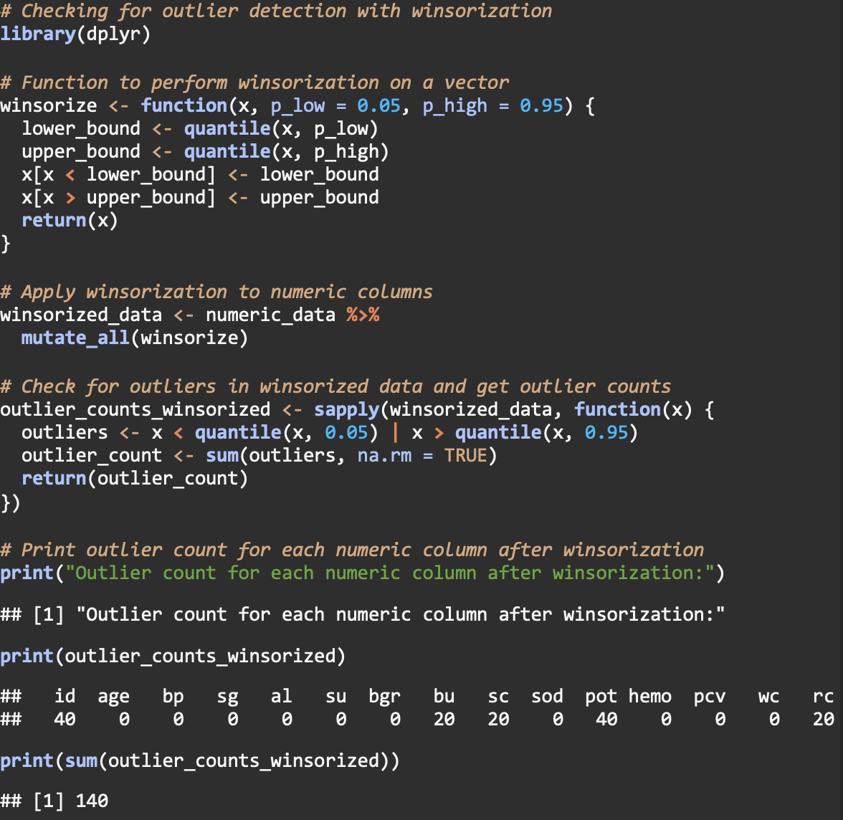
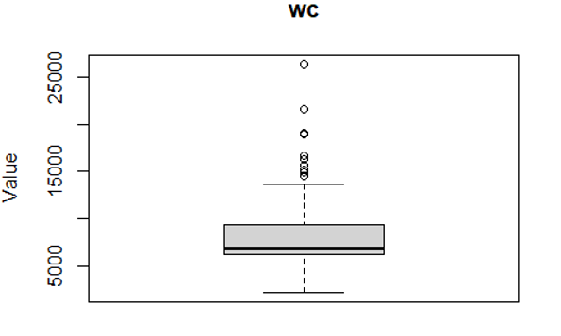
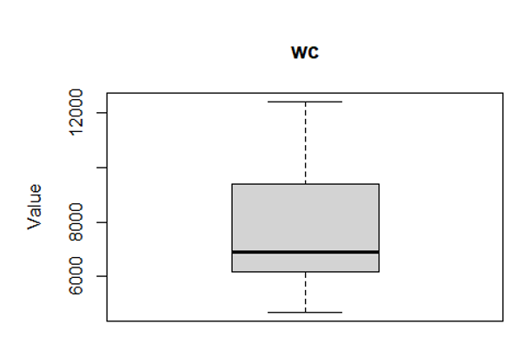
Data Cleaning
Outlier Detection using IQR:
We checked for outliers by using the IQR method and found out that the number of outliers was 377.
Outlier Detection and treatment using Winsorization:
It is a technique where data is capped at 5% and 95%. Data points beyond this were identified as outliers. Using this technique, we discovered a total of 140 outliers.
Outliers were treated with the upper bound and lower bound values using Winsorization technique.

Slide 8
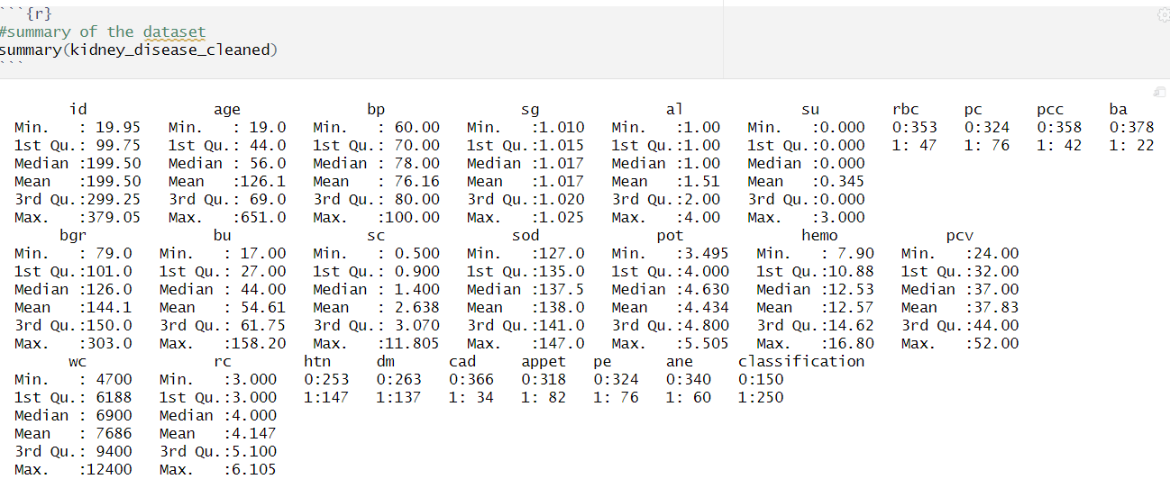
Data Cleaning
We then used summary() to understand descriptive statistics for our cleaned dataset.​

Slide 9
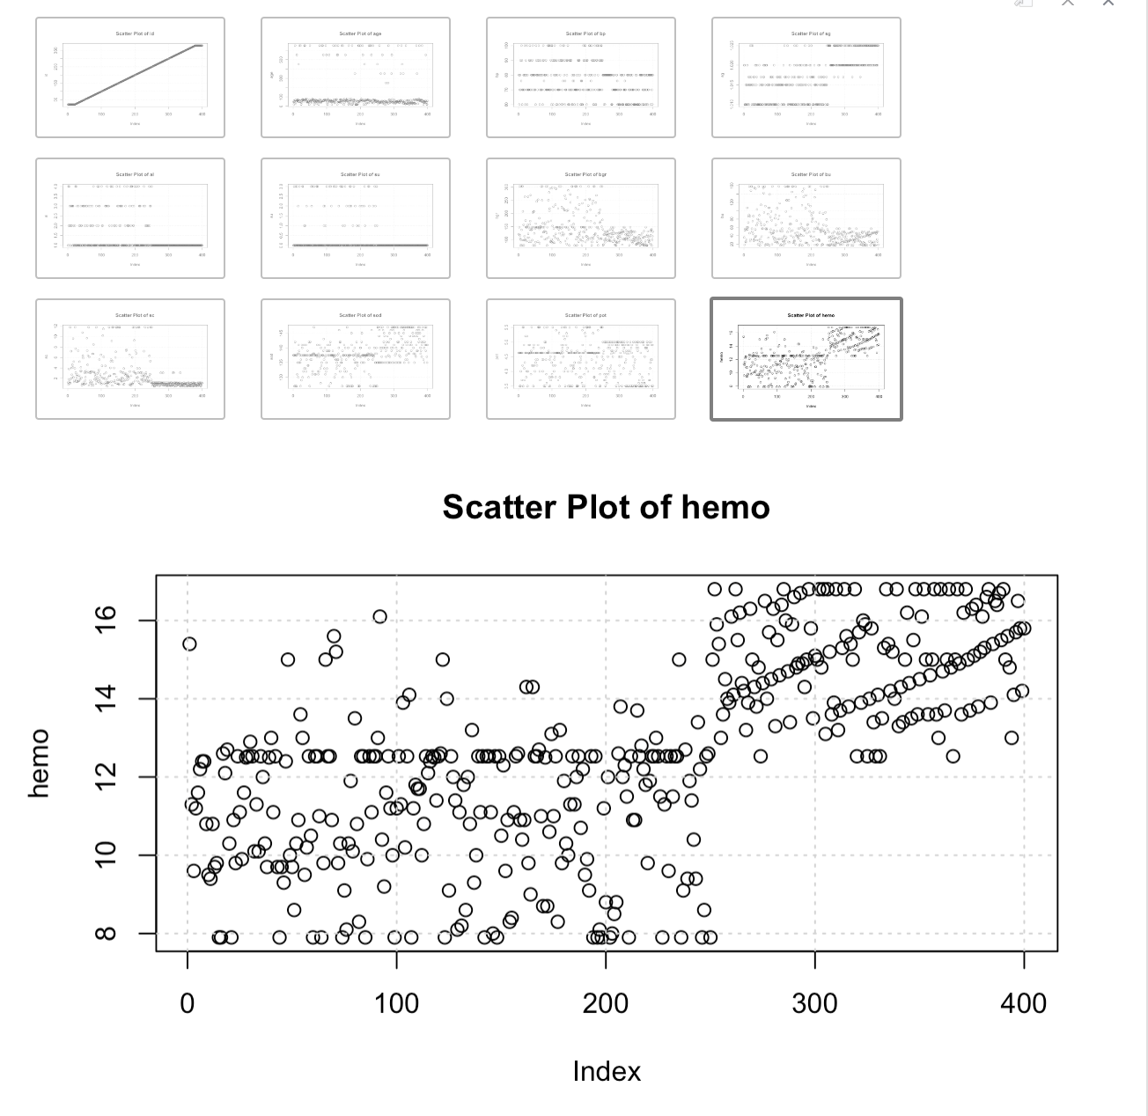
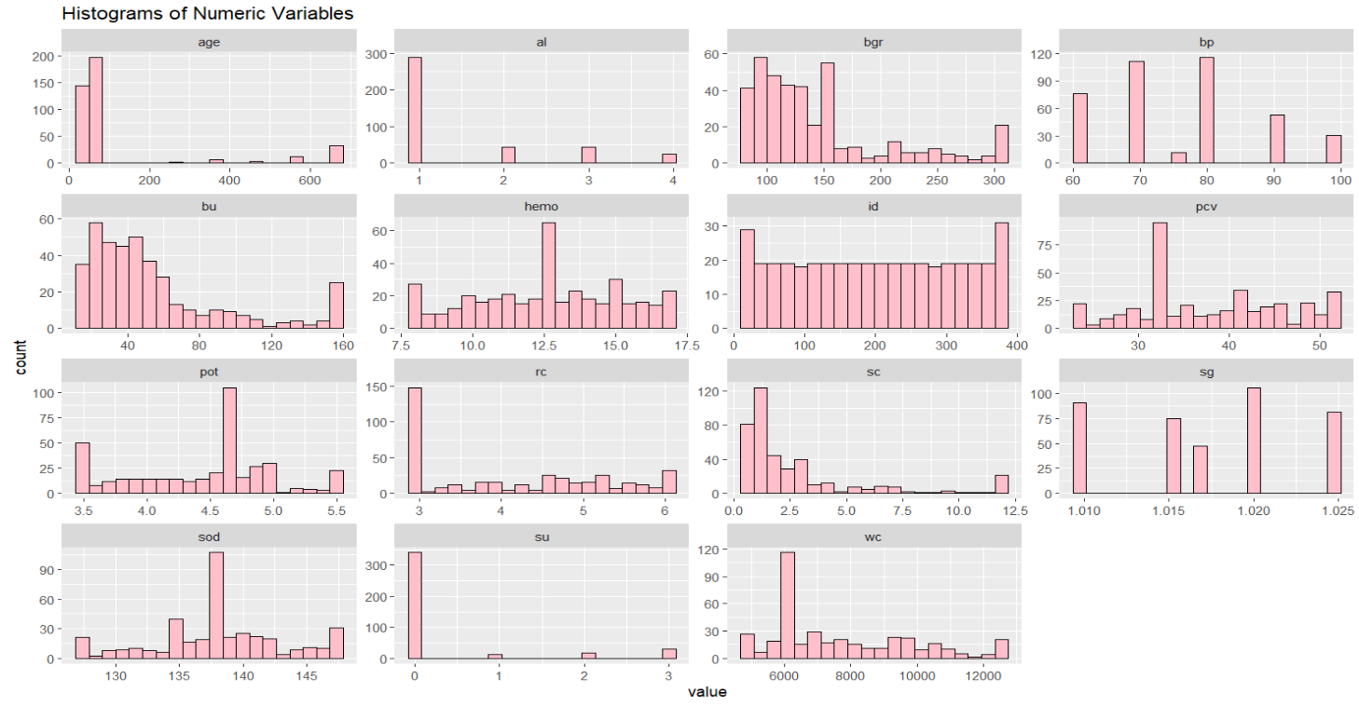
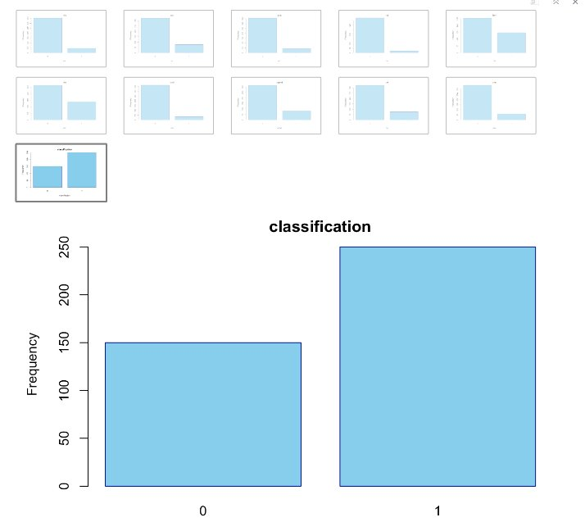
EXPLORATORY DATA ANALYSIS
Data Visualization
We have plotted scattered plots for numeric variables to understand the distribution of the variables.
We also plotted histograms for the numeric variables to understand the distribution of variables.
For Categorical variables, we have plotted barplots to understand the frequency for each variable in the dataset​

Slide 10
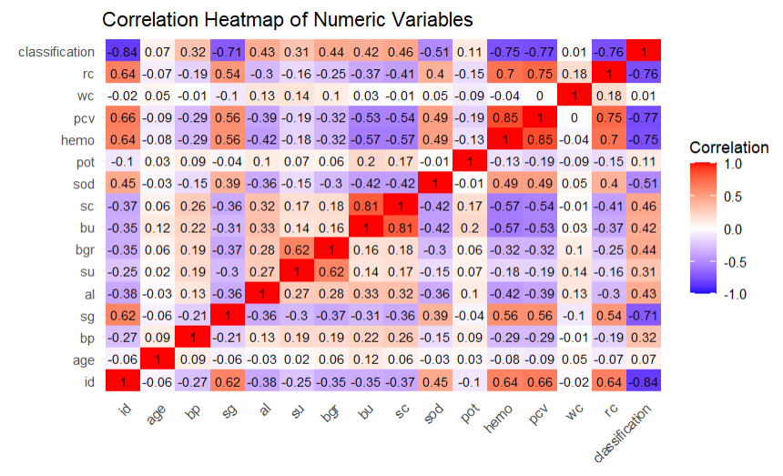
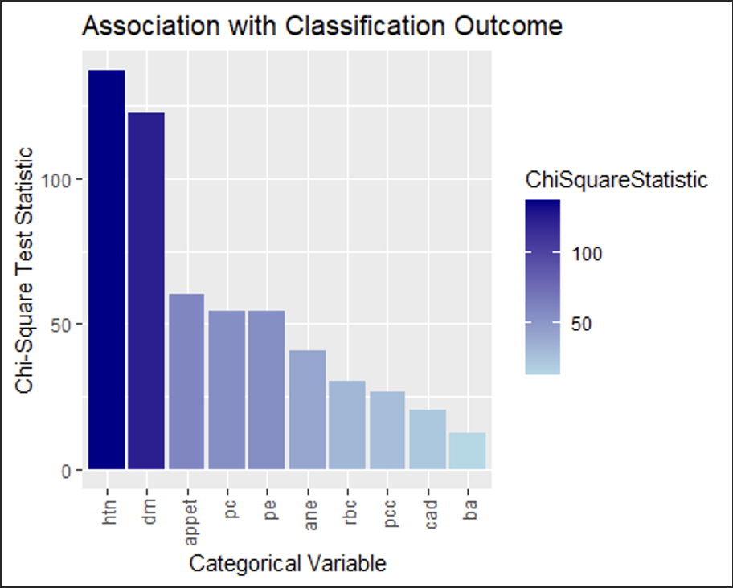
Correlation coefficient test & Chi-square test
We performed correlation analysis between numerical variables and classification to evaluate the association between variables. A heatmap was plotted to visualize the correlation.
For categorical variable, chi-square test was utilized to evaluate the association between the variables.
Categorical Variable | X-squared | P-value
Htn vs CKD | 136.93 | < 2.2e-16
dm vs CKD | 122.6 | < 2.2e-16
cad vs CKD | 20.581 | 5.717e-06
appet vs CKD | 59.891 | 1.003e-14
pe vs CKD | 54.338 | 1.688e-13
ane vs CKD | 40.492 | 1.975e-10
rbc vs CKD | 30.167 | 3.963e-08
pc vs CKD | 54.338 | 1.688e-13
pcc vs CKD | 26.397 | 2.78e-07
Ba s CKD | 12.326 | 0.0004466

Slide 11
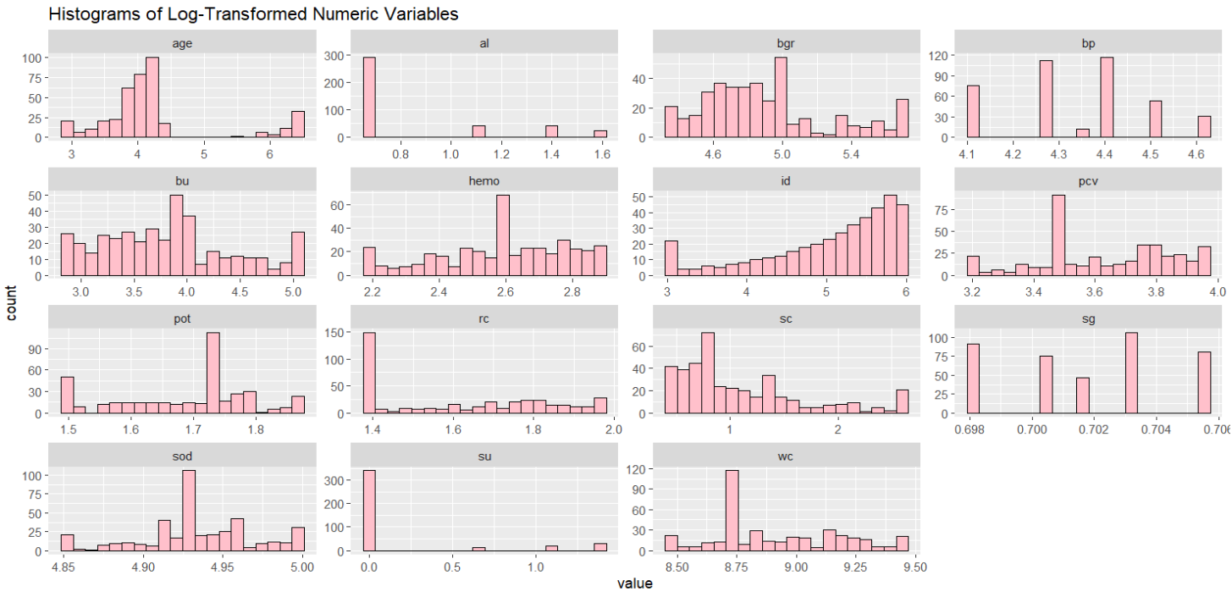
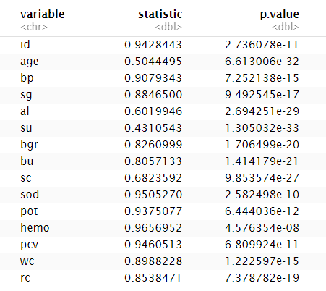
Checking for Normality and Log Transformation
Log transformation was performed to treat the skewness of the distribution of variables. But no change in the distribution is observed after transformation.
We conducted a normality testing using the Shapiro-Wilk test to evaluate the distribution of the variables across the dataset and to ascertain whether it adheres to a normal distribution. Histograms were also plotted to visualize the data.
As the p-values are less than 0.05, it can be said that the data is not normally distributed.

Slide 12
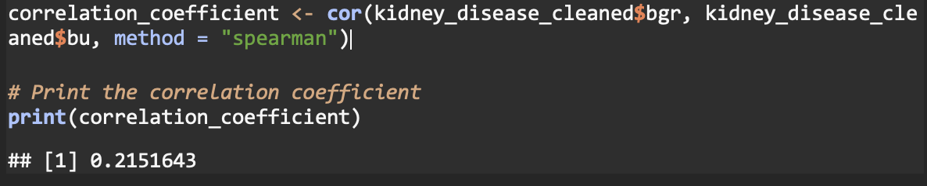
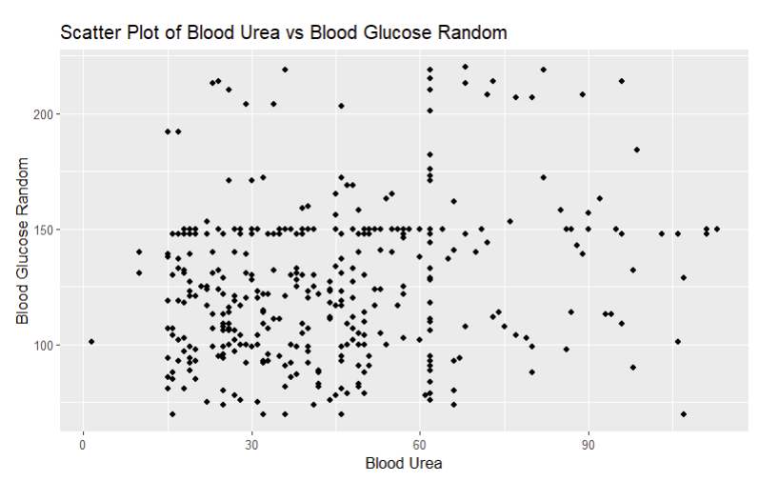
Research Question 1
What is the association between blood glucose levels (bgr) and blood urea levels (bu) with chronic kidney disease?
Correlation Analysis
Scatter Plot
A scatter plot using ggplot2 to visualize the association between the "bgr" and "bu" variables. to understand any relationship between these two variables and its distribution. It reveals no clear linear association between "bgr" (blood glucose random) and "bu" (blood urea) levels. The data points are widely scattered, indicating a lack of strong correlation between the two variables.
As the data is non-normally distributed data, Spearman's correlation, a non-parametric measure of association, is an appropriate choice for the given dataset.
A correlation coefficient of 0.2151 between the variables "bgr" and "bu" suggests a weak positive correlation. This means that as the values of one variable increase, the values of the other variable tend to increase as well. However, the correlation is considered weak, suggesting that the relationship between these variables is not very strong.​
​

Slide 13
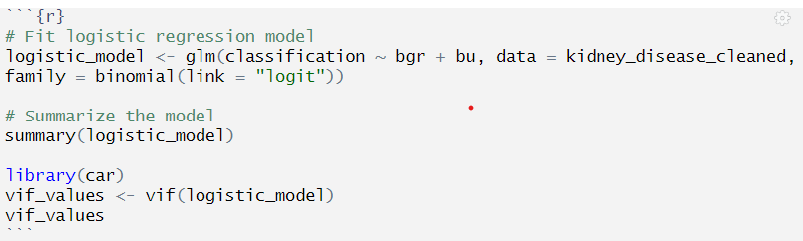
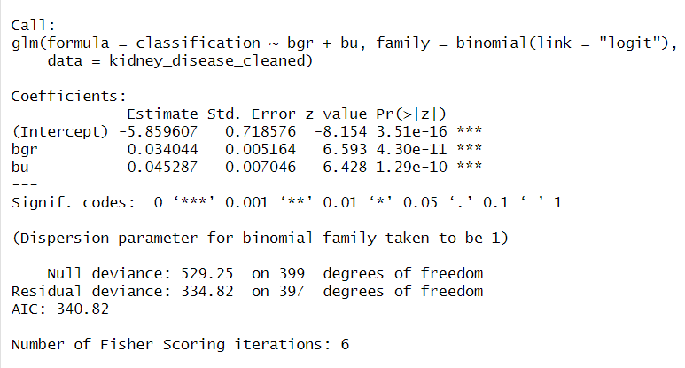
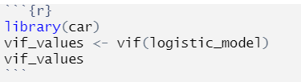
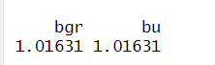
Fitting logistic regression model
The logistic regression model reveals that for each unit increase in blood glucose levels (bgr), the log odds of chronic kidney disease increase by approximately 0.034 (p < 0.001). ​
For each unit increase in blood urea levels (bu), the log odds of chronic kidney disease increase by approximately 0.045 (p < 0.001). ​
The intercept of –5.859 (p < 0.001) represents the log odds of chronic kidney disease when both bgr and bu are zero. ​
As the p-values are less than 0.05, the null hypothesis is rejected suggesting there is evidence to suggest that there is a significant association between blood glucose levels (bgr) and blood urea levels (bu) with chronic kidney disease (CKD).​
A Variance Inflation Factor (VIF) of 1.01631 for "bgr" and "bu" suggests negligible multicollinearity, indicating stable variance for these coefficient estimates in the regression model.

Slide 14
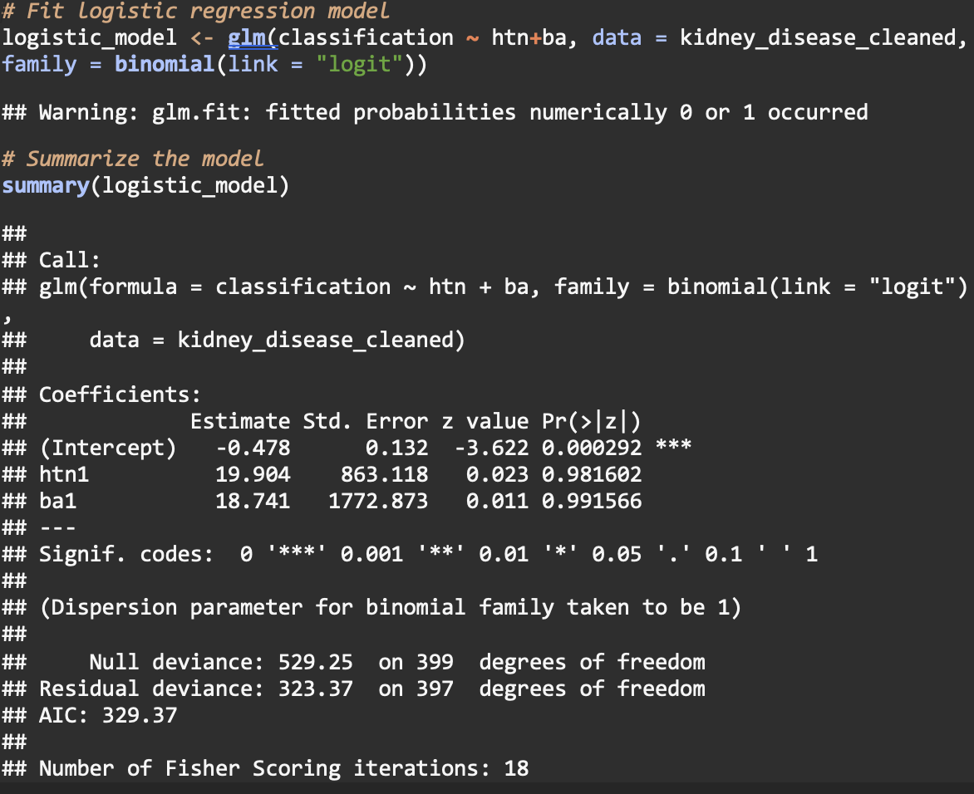
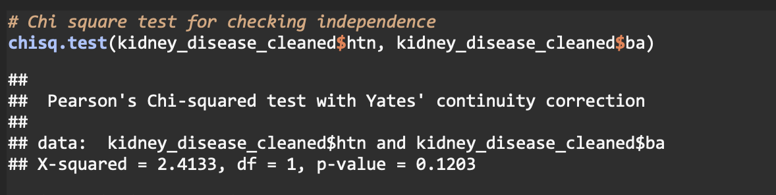
Research Question 2
Logistic Regression Model
What is the association between bacteria (ba) and hypertension (htn) with chronic kidney disease?
Chi-square test
Chi-square test was done to evaluate the association between the independent categorical variables. Chi-square test was done for all categorical variables, and htn and ba are the variables that didn’t show multi co-linearity. The chi-square test for independence between ba and htn with chronic kidney disease yielded a p-value of 0.1203, indicating no significant association between the two variables.
The intercept is estimated to be –0.476 which implies that when hypertension (htn) and bacteria (ba) are zero, the log-odds of the outcome is expected to be approximately –0.476.
For every one-unit increase in htn, the log-odds of the outcome are expected to increase by 19.90, while for ba, the log-odds of the outcome are expected to increase by 18.74.
Due to their high p-values (0.982 and 0.991, respectively), we fail to reject the null hypothesis suggesting that there is a significant association between hypertension (htn) and bacteria (ba) with chronic kidney disease (CKD).

Slide 15
Limitations
Sample Size and Generalizability: With only 400 observations, the dataset may not be representative of the entire population, potentially limiting the applicability of the findings to different or broader groups.
Presence of Missing Values: Imputing missing values can introduce biases, especially if the missing data patterns are not random. This method relies on the assumption that missing values resemble the observed data.
Potential for Residual Confounding: The study could be limited by unmeasured variables that may influence the outcomes, such as dietary habits, lifestyle choices, or genetic factors, which are not included in the dataset.
Data Processing and Outlier Management: Outlier management techniques used, like winsorization and replacement, may not fully address their impact on the analysis and can be subjective, leading to potential data distortion.

Slide 16
References
Kovesdy C. P. (2022). Epidemiology of chronic kidney disease: an update 2022. Kidney international supplements, 12(1), 7–11. https://doi.org/10.1016/j.kisu.2021.11.003

Slide 17
Appendix:
Figure 1: Code to import dataset
Figure 3: Code for head of the dataset
Figure 2: Code for dimensions, number of rows and columns
Figure 4: Summary of the dataset

Slide 18
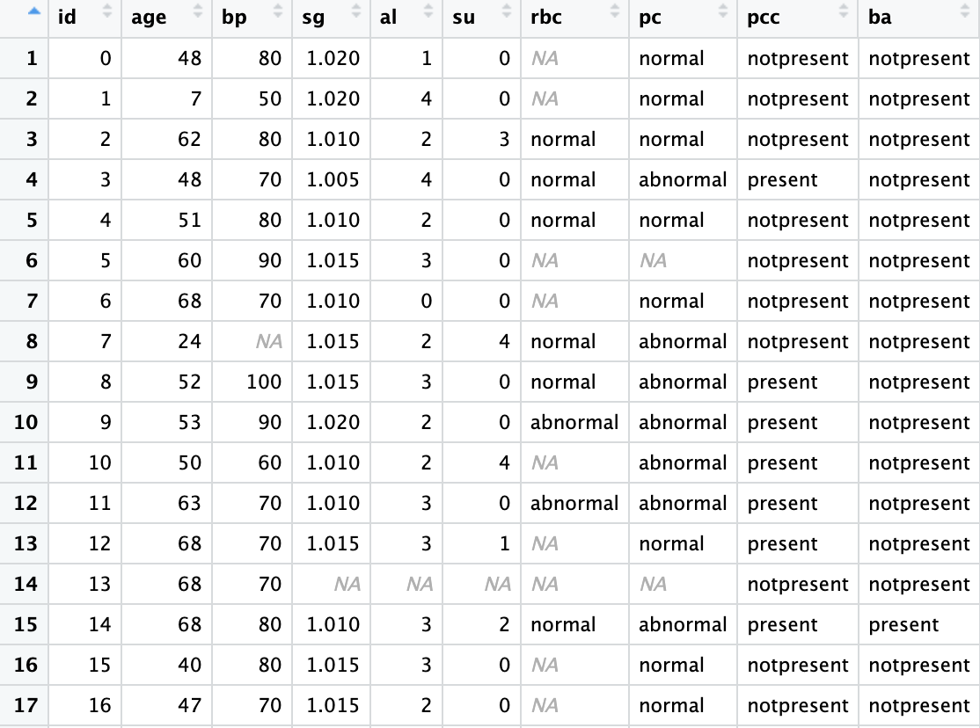
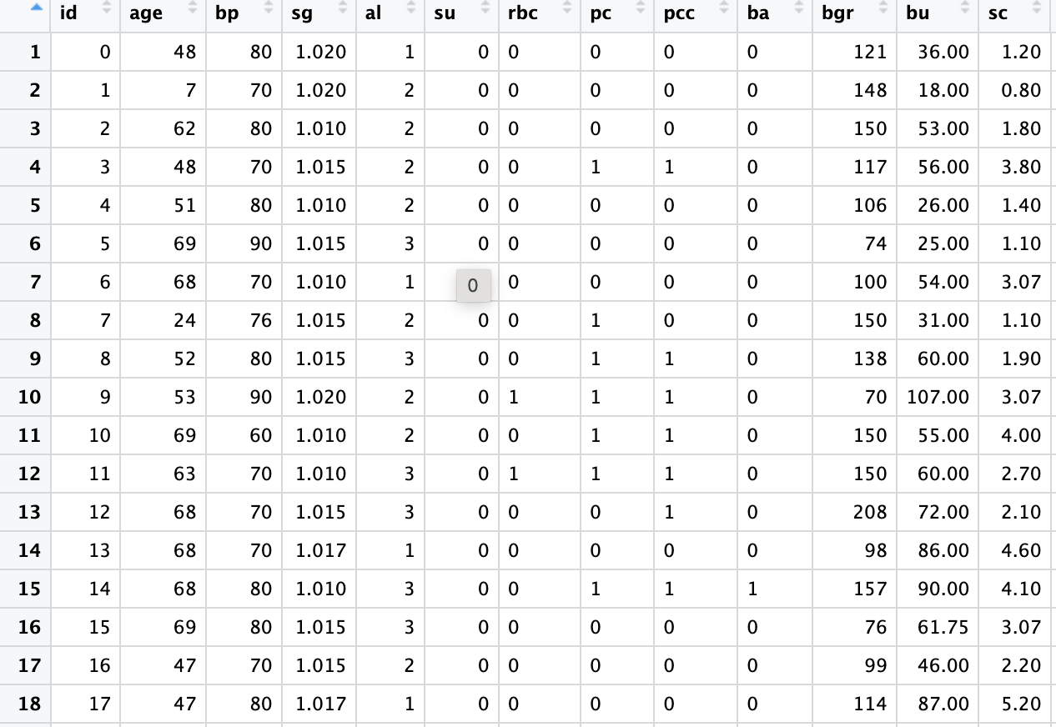
Appendix:
Figure 5: Dataset before cleaning
Figure 6: Dataset after cleaning

Slide 19

Appendix:
Figure 7: Code to check the total count of null values
Figure 8: Code to check null values per column
Figure 9: Code for datatype conversion

Slide 20
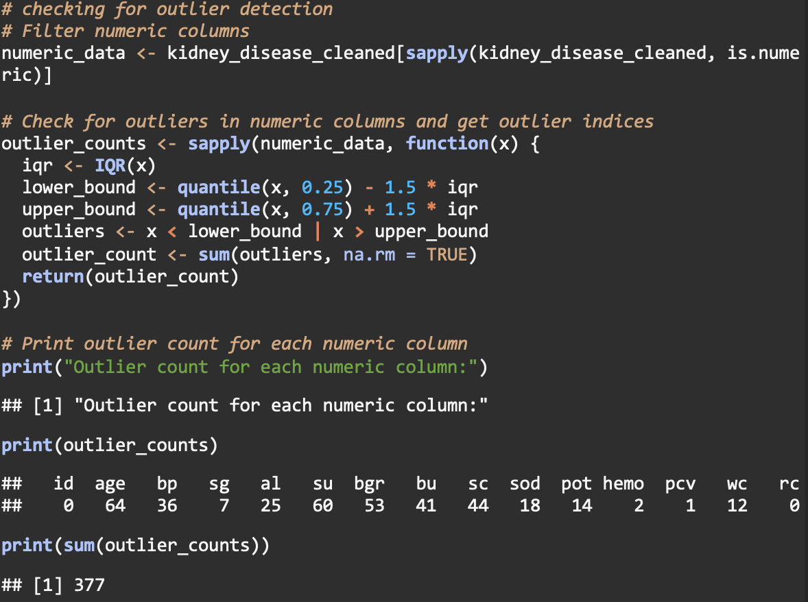
Appendix:
Figure 11: Outlier detection using Winsorization
Figure 10: Outlier detection using IQR
Figure 11: Code for apply winsorization

Slide 21


Appendix:
Figure12: Data visualization for outliers before winsorization
Figure 13: Data visualization for outliers after winsorization

Slide 22
Appendix:
Figure 14: Summary of the dataset

Slide 23
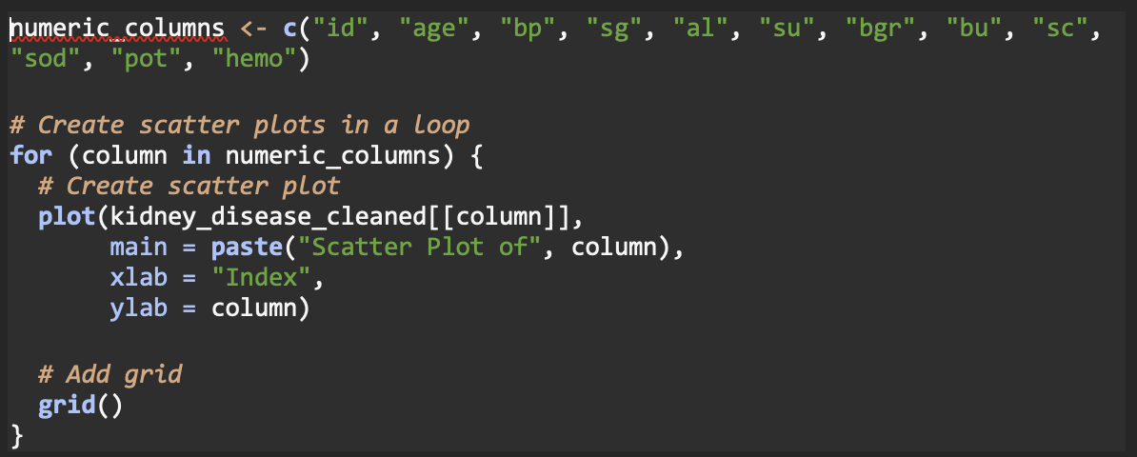
Appendix:
Figure 15: Code for scattered plots for numeric columns
Figure 16: Scattered plots for numeric columns

Slide 24
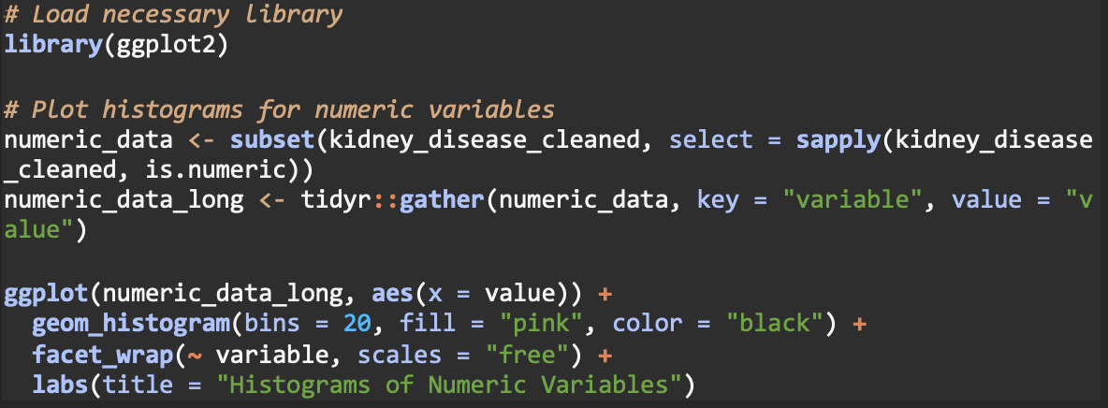
Appendix:
Figure 17: Code for histograms for numeric variables
Figure 18: Histograms for numeric variables

Slide 25
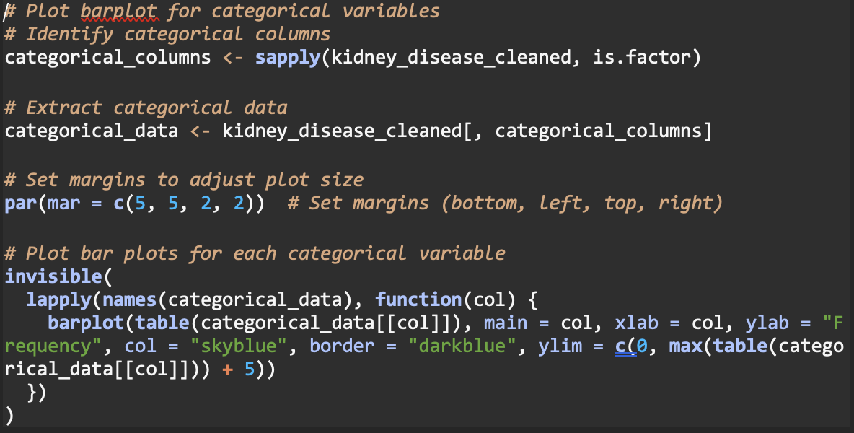
Appendix:
Figure 19: Code for barplot for categorical variables
Figure 20: Barplots for categorical variables

Slide 26
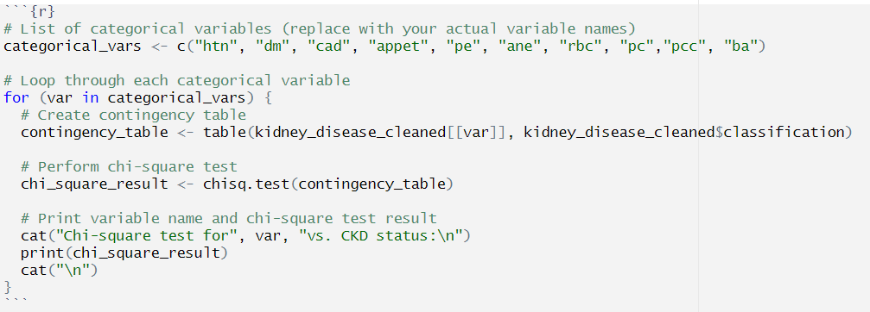
Appendix:
Figure 22: Code for chi-square test
Figure 21: Heatmap of Numeric variables
Figure 23: Data visualization for Categorical variables

Slide 27
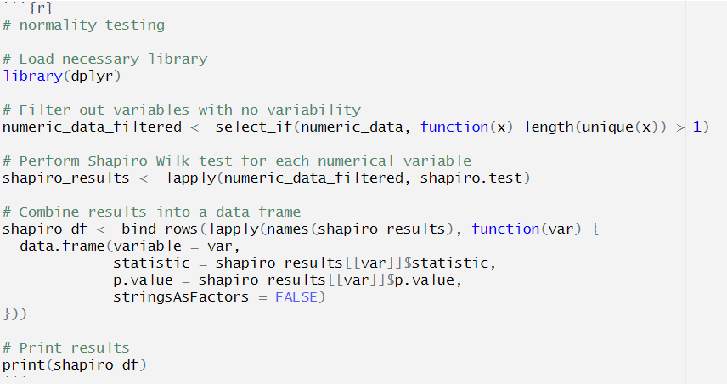
Appendix:
Figure 24: Code for normality testing
Figure 25: Output for normality testing

Slide 28
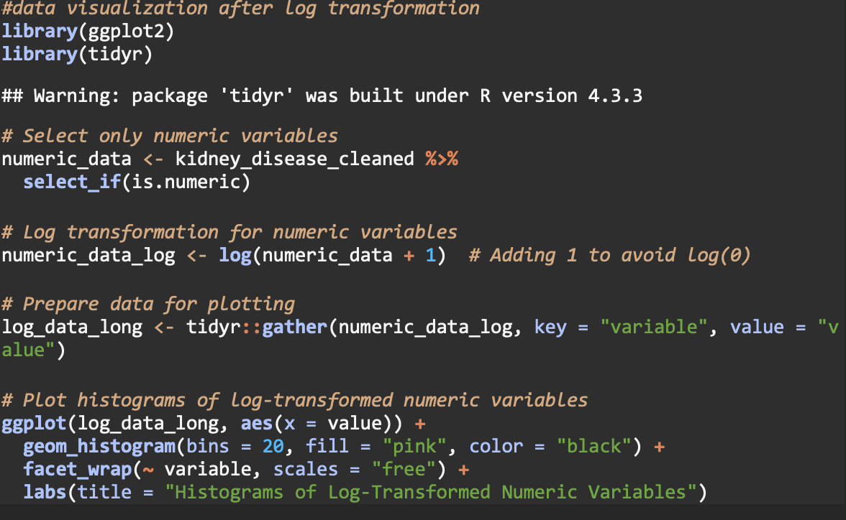
Appendix:
Figure 26: Code for log transformation
Figure 27: Histogram after log transformation

Slide 29
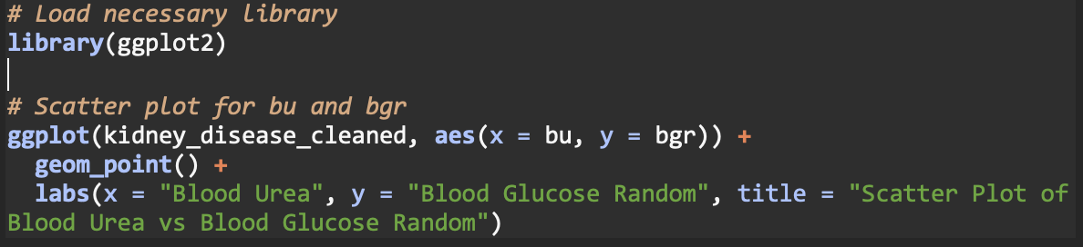
Figure:

Slide 32

THANK YOU!

